Slide 1

Richland County Voluntary Buyout Program
Community Meeting
September 20, 2018

Slide 2
Agenda Overview
Welcome & Introductions
Description of the Buyout Program
County Buyout Project Update
Communicating with the Property Owners
Tentative County Plans for the Purchased Property and Receiving Your Input
Closing/Questions

Slide 3
Richland County Team
Tracy Hegler – Planning Director
Mike King – Richland County Recovery Manager
Synithia Williams – Stormwater General Manager
Valeria Jackson – Community Development Director
Ashley Powell – Planning Division Manager
Quinton Epps – Conservation
Liz McDonald – County Assessor
Pat Beekman – Consultant, Tetra Tech

Slide 4
Description of the Buyout Program
Hazard Mitigation Grant Program ----The purpose of the HMGP program is to help communities implement hazard mitigation measures following a Presidential major disaster declaration.
Hazard mitigation is any action taken to reduce or eliminate long term risk to people and property from natural hazards.
The HMPG is authorized under Section 404 of the Robert T. Stafford Disaster Relief and Emergency Assistance Act.
State of South Carolina administers the HMGP program and prioritize projects. Because HMGP funding is limited, the State must make difficult decisions as to the most effective use of grant funds. After reviewing project applications to determine if they meet the program’s requirements, the state forwarded the applications to FEMA for review and approval.

Slide 5

Description of the Buyout Program
For the buyout program, FEMA pays the County 75% of the overall cost to buy the property; destroy any structures and haul away the debris; return the property to a natural state; and implement the program.
The County is using Community Development Block Grant – Disaster Recovery (CDBG-DR) funds the County has received from the U.S. Department of Housing and Urban Development (HUD) to cover the other 25% of the costs.

Slide 6

What Does This Mean To You?
The property owner will receive FULL current fair market value for your property (based on a third party appraisal).
Because the County is using two different Federal agencies (FEMA and HUD) and programs (HMGP and CDBG-DR) to buy the properties, the County and the property owner must comply with the requirements of both programs.

Slide 7
Project Update – Timeline
FEMA has approved the buyouts for this project.
The County is acquiring a company to implement the buyouts, an appraisal firm to determine fair market value and a demolition contractor to destroy the homes, haul away the debris, and return the properties to a natural state. The County has already acquired closing attorneys to execute the purchases of the properties.
The County is preparing the proposal for obtaining an appraisal firm. Once released, it will take the County approximately a month to acquire an appraisal firm.

Slide 8
Project Update – Timeline
Once the County has selected an appraisal firm, the appraisals should take approximately 45-days.
Once the appraisals are complete, the closing process should take another 45-days.
Once the purchase of all the properties are completed, the demolition phase should last no more than 90-days.

Slide 9

Communicating With You
The County will continue its monthly calls to all property owners until the County has purchased their property.
Other methods of contact include:
  Email - RichlandCountyHMGP@sites.tetratech.com
  Hotline - 803-873-9295
  On Site Documentation Drop Off
  And of course, everyone knows my phone number!
  (Pat Beekman 980-417-3309)

Slide 10

Key Phases for Property Owners
Phase | Description
Pre – Offer Phase | Complete and Submit all Required Paperwork Formal Appraisal of the Property Title Search Dealing with Tenants/Renters, etc. Environmental Inspection
Offer Phase | Preparing Voluntary Offer to Sell Documents Program review of Duplication of Benefits Documents Offer meeting Acceptance of offer from property owner
Closing Phase | Schedule and Conduct Closing County Commissioner approval Vacancy Inspections Closing of the Property

Slide 11

County Plans for the Property
Land Management Committee has been established to make recommendation to Blue Ribbon Committee and Council
Land Management Committee wants your input as to what you want done with the property
Bottom line: The County must comply with FEMA requirements of the program
  The County must own the property forever
  There are severe restrictions on what the County can place on the property

Slide 12
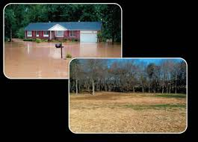
Next Steps After Demolition
Staff recommendation for the bought properties
Further flood mitigation to alleviate downstream flooding
Consider long term maintenance
Include input received from neighboring property owners
Add project in Stormwater Management’s Capital Project’s Database

Slide 13
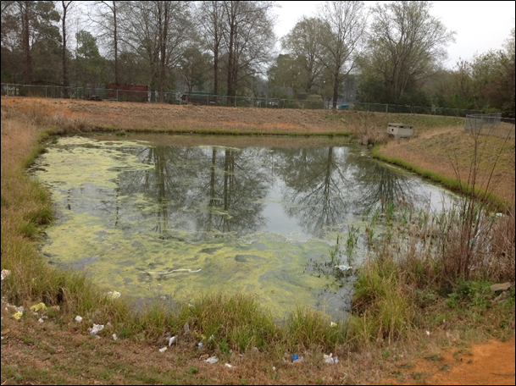
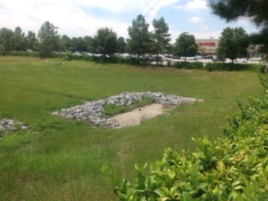
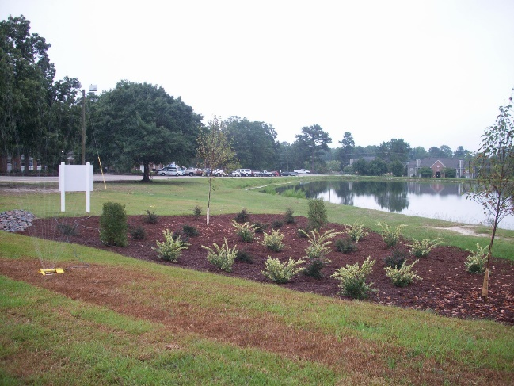
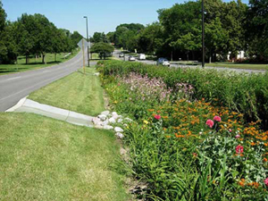
Ideas to Consider
Wet Pond
Dry Pond
Bio-retention
Bio-swale

Slide 14
Redevelopment Next Steps
Complete demolition
Solicit Design Engineering Firm
(3 months)
Project Design
(3-9 months)
Request Bids from Contractors
(3 months)
Project Construction
(6-9 months)
These are estimated timelines that can be extended based on funding, contractor estimates, etc.

Slide 15

Closing/Questions?/Collect Documents

