Slide 1
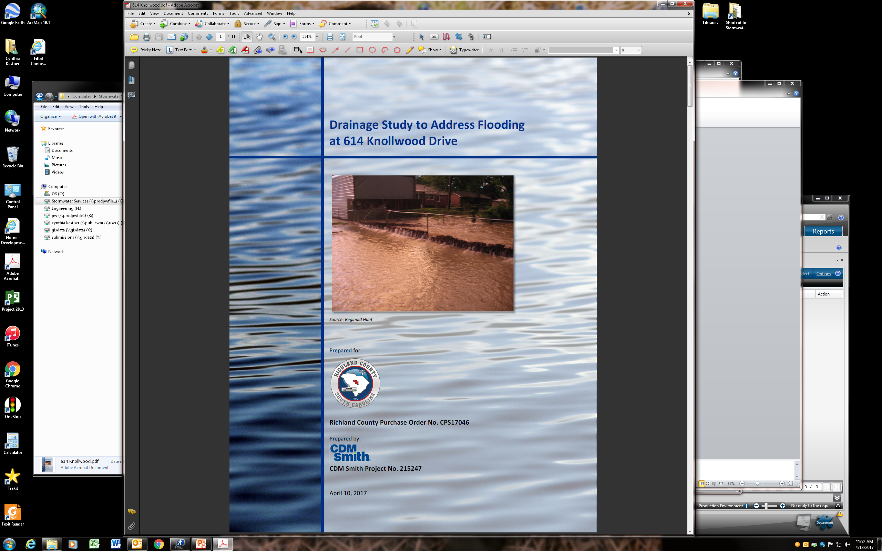

Slide 2
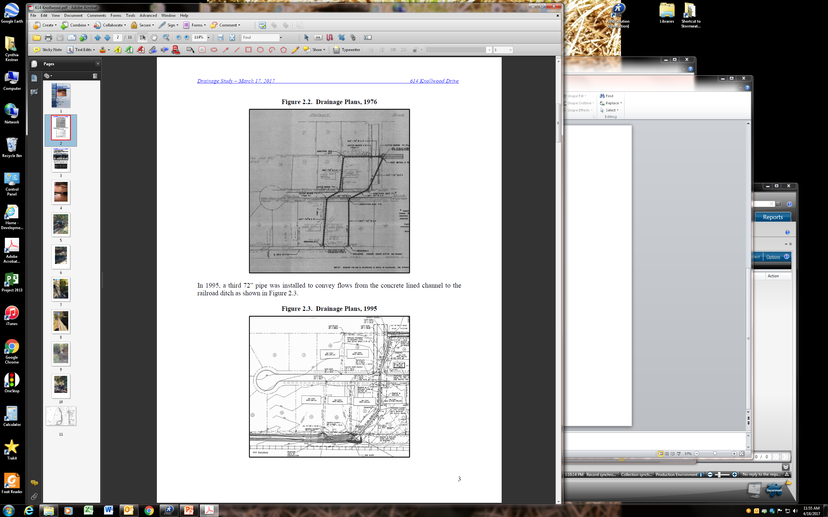

Slide 3
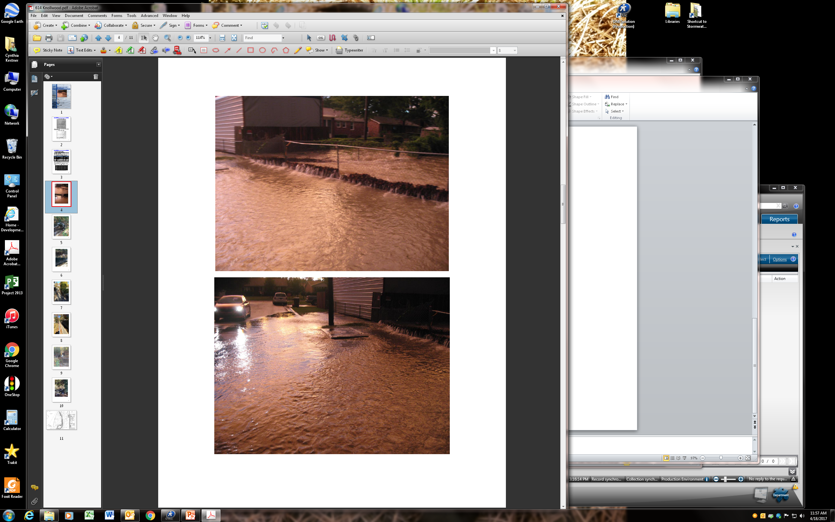

Slide 4
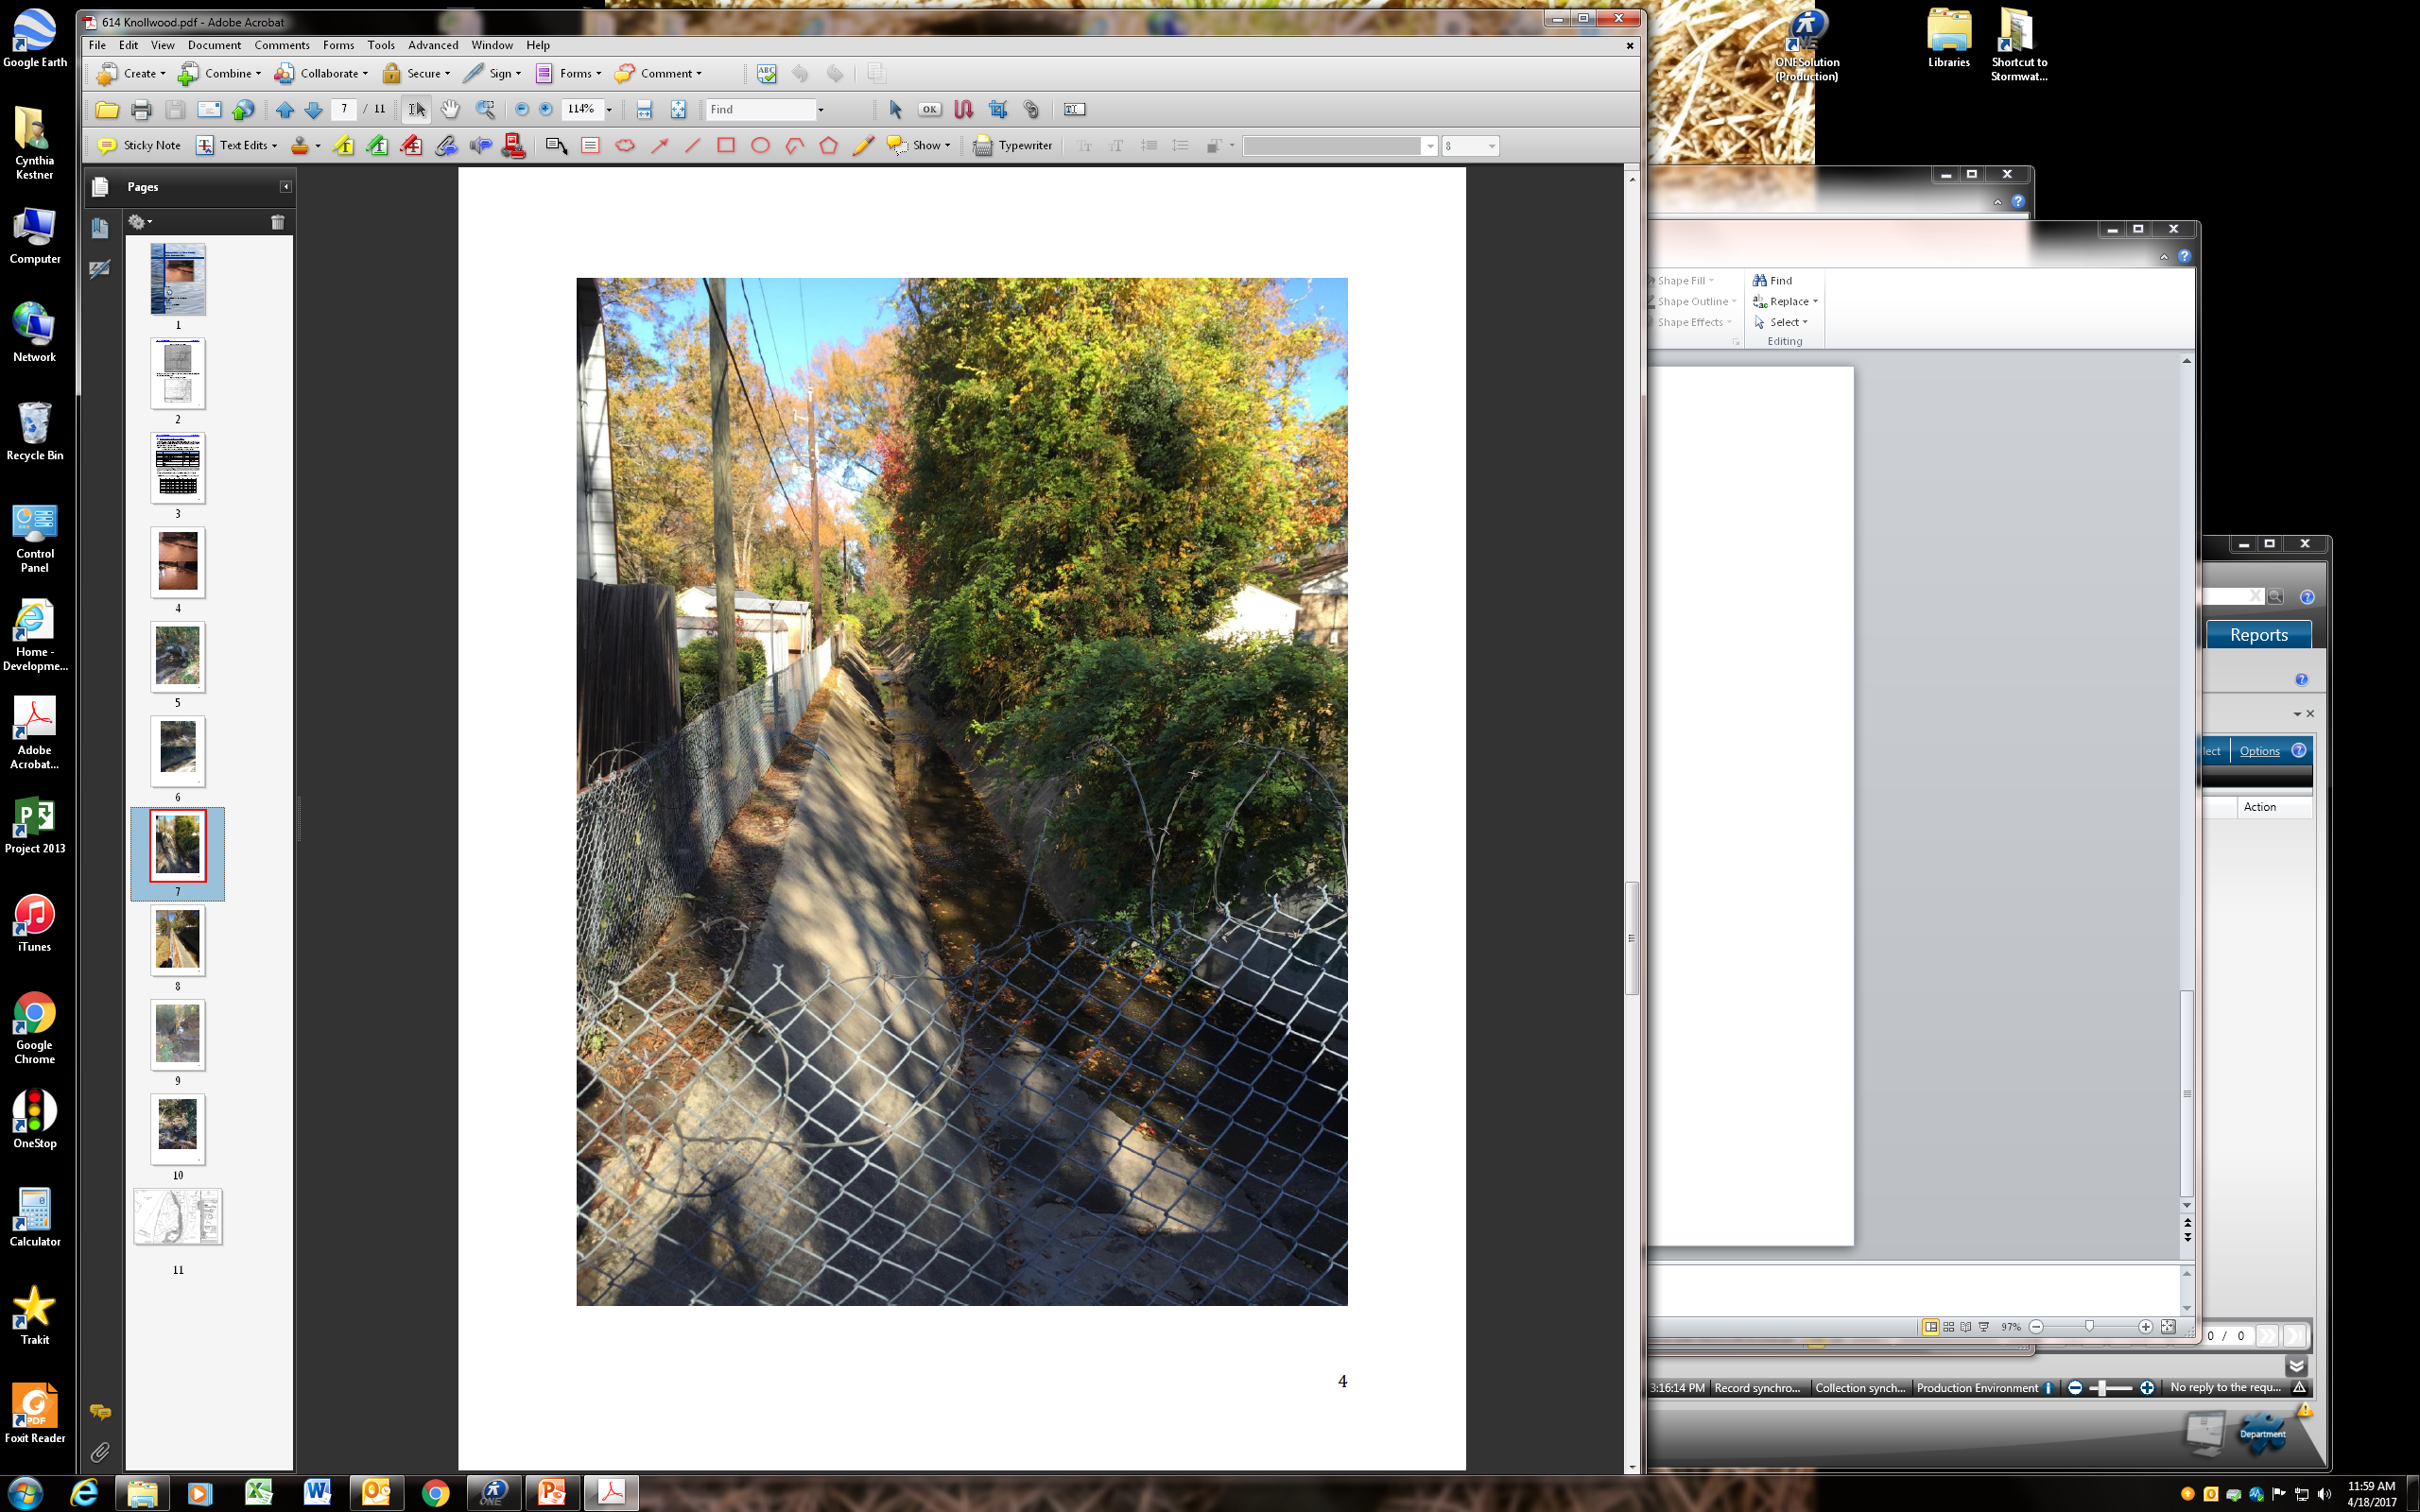

Slide 5
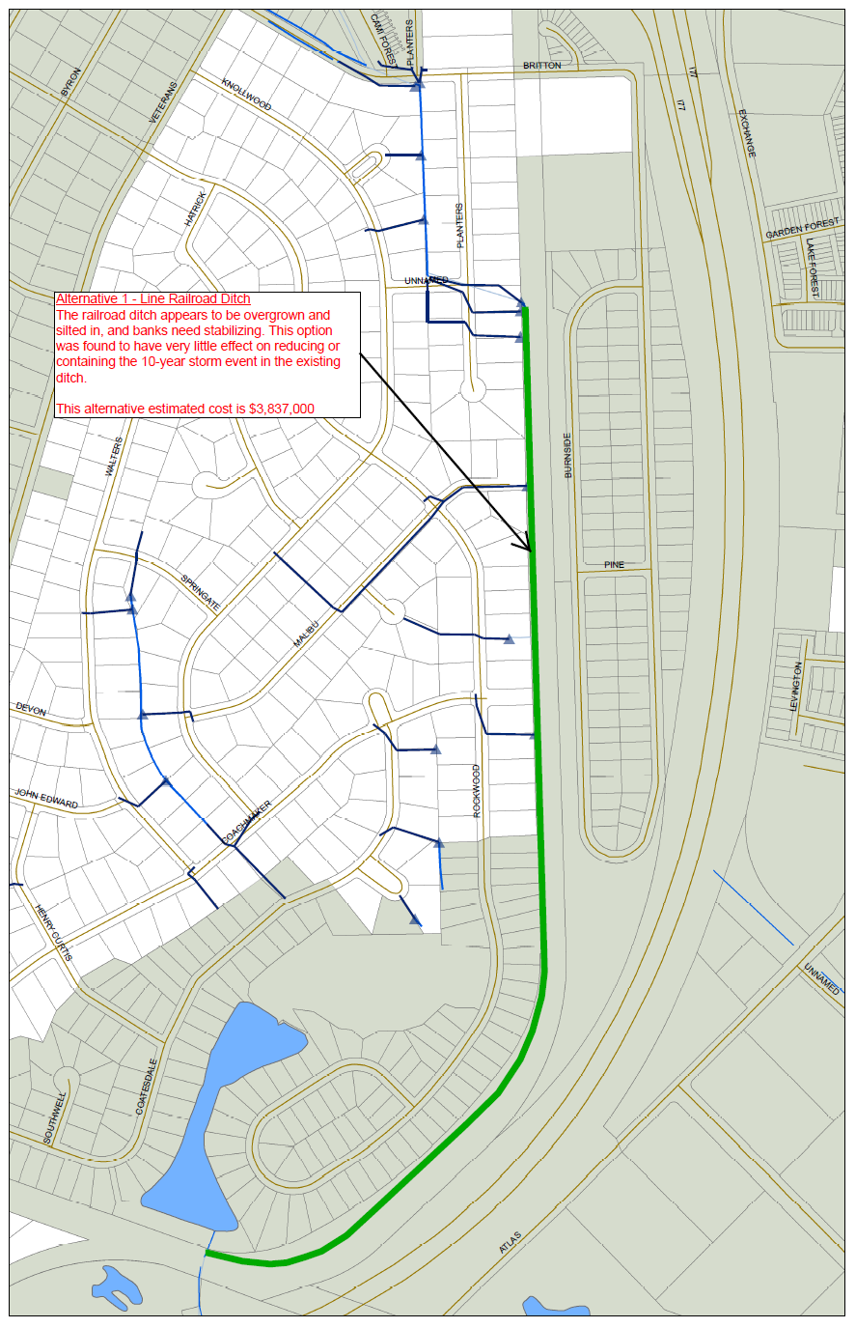

Slide 6
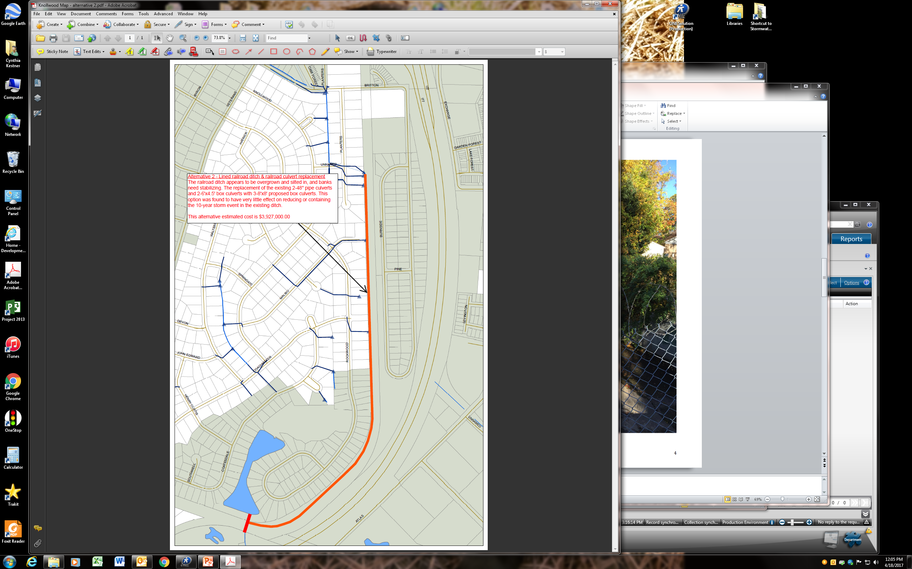

Slide 7


Slide 8


Slide 9
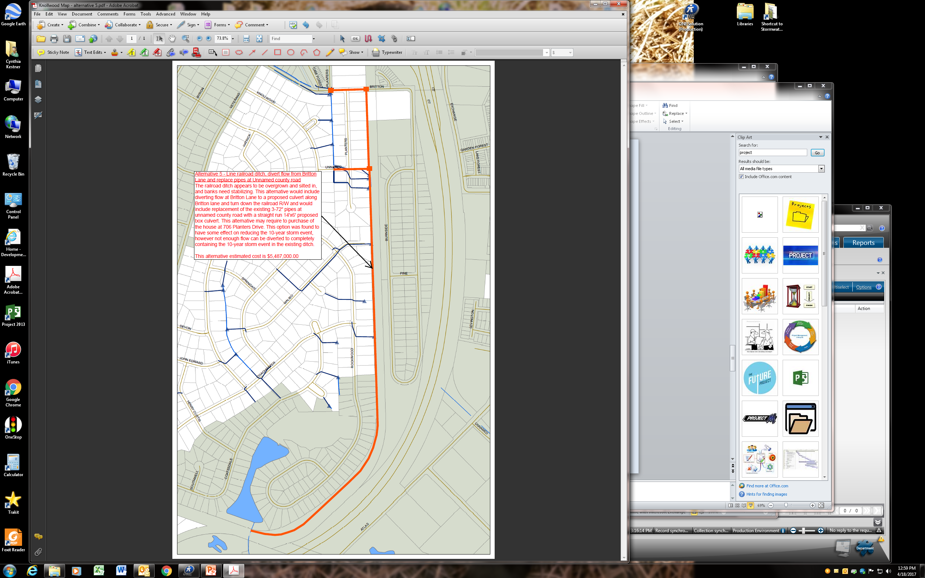

Slide 10
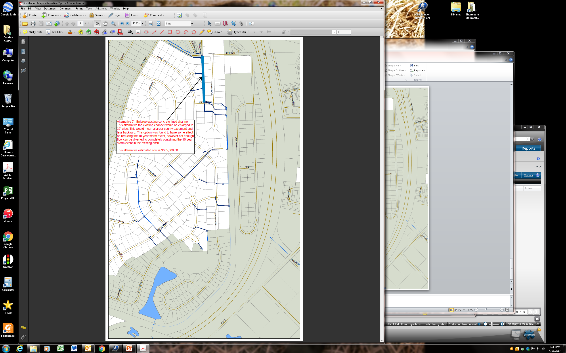

Slide 11
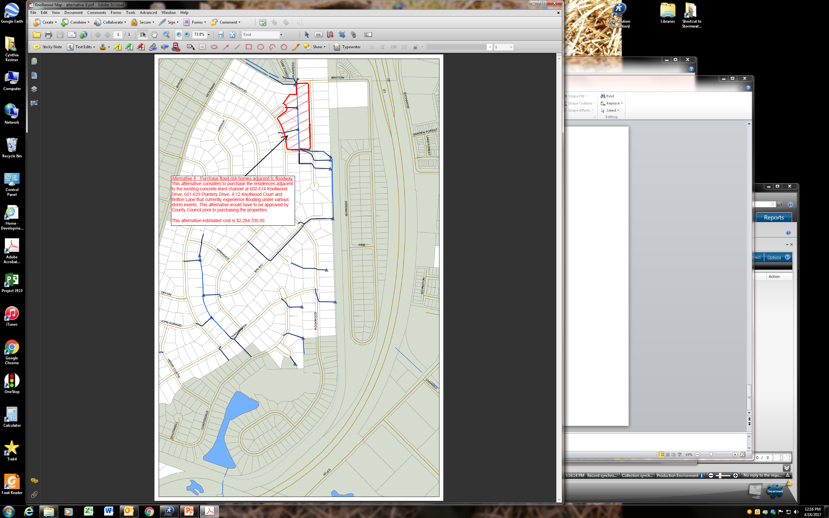

Slide 12
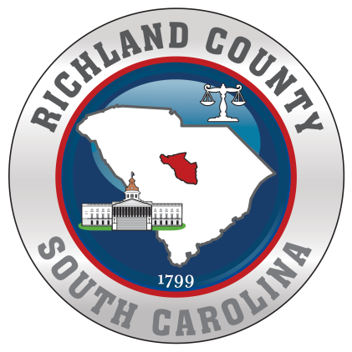
Knollwood Dr. Drainage Study Community Meeting
Current Funding Sources
2017 Stormwater Capital Budget | $301,817
2018 Requested Stormwater Budget | $1,495,690
2019 Requested Stormwater Budget | $1,679,592
Potential Funding Options
Hazard Mitigation Grant Funding | Can be used for home buyouts in the special flood hazard area.
CDBG-DR Grant | Can be used for home rehabilitation if area meets income requirements
In the Short Term:
Wait on results of the 2018/2019 Budget approval. Currently $165,000 in the Stormwater Budget for Knollwood Improvements;
  a. Re-line and clean out ditch at a minimum;
Contact the railroad concerning maintenance of the ditch in their easement;
Gauge interest in residents on buyout options;
Research additional grant funding that may assist with improvements.

