Slide 1
Richland County Transportation Improvement Work Session #1
March 12, 2024

Slide 2
Work Session #1
Transportation Needs
Funding
Project Principles
Categories
Input and Advice
Roadmap Review
2023 Resolution of County Council
TPAC Resolution

Slide 3
2023 Resolution of County Council

Slide 4
Transportation Needs
Process Review
RFP
Community Meetings
Engagement with Local Governments and COG
Unfinished Projects
Funded
Unfunded
Project List
Summary of community feedback
Review project highlights
Additional work to be completed
Time horizon

Slide 5
Transportation Needs
Project Costs
Cost estimating
Accounting for inflation
In excess of $2 Billion
Only includes transportation projects
Does not account for COMET needs

Slide 6
Funding
Traditional tools to fund Transportation Needs
Pay as you go
County Bonds
Insufficient capacity and will eliminate capacity for other capital needs of the County
Grants
Will not be enough to serve as a primary source
Size of Transportation Needs Requires Additional Source
Other counties are utilizing transportation pennies
Consider continuing the transportation penny
6

Slide 7
How Much Is a Transportation Penny Worth?
15-year Transportation Penny
$2.2 billion

Slide 8
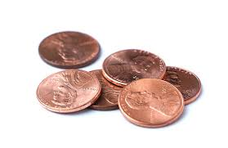
Funding
How to Divide the Transportation Penny?
TRANSPORTATION PROJECTS
CMRTA – COMET BUS SYSTEM
8

Slide 9
Project Principles
County Council established guidelines for how and where the proceeds of the next transportation penny will be used to fund the County’s transportation needs.

Slide 10
Project Principles
The principles would provide specific direction on key questions:
How to prioritize projects remaining from the current penny project list?
How to divide the penny among project categories that will appear on the ballot?
What factors, i.e. needs of community, safety, access, etc. should be prioritized?
What portion of the penny, if any, should be reserved and set aside to address future projects of strategic or critical importance to the County?

Slide 11
Categories
COMMUNITY INVESTMENT PROJECTS
Ballot questions for transportation pennies have taken many forms. Some list projects but others include larger categories. Some allocate dollar amounts to categories and others use percentages.
COUNTY ADVANCEMENT PROJECTS
COMET ENHANCEMENT PROJECTS
11

Slide 12
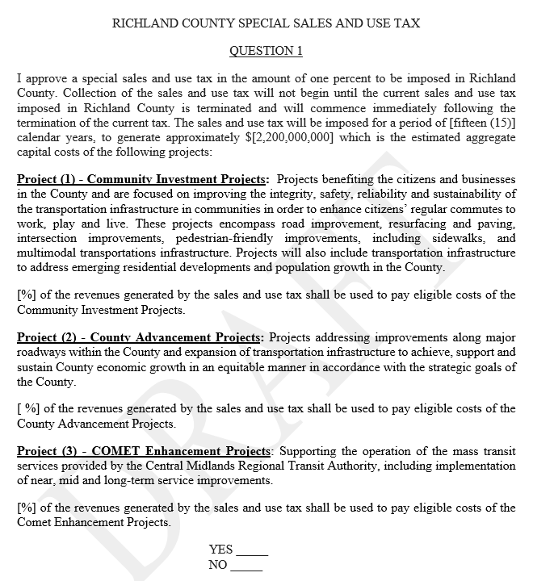

Slide 13
Community Investment Projects
These projects benefit citizens and businesses in the County and are focused on improving the integrity, safety, reliability and sustainability of the transportation infrastructure in communities in order to enhance citizens’ regular commutes to work, play and live. These projects will mostly encompass road improvement, resurfacing and paving, intersection improvements, pedestrian-friendly improvements, including sidewalks, and multimodal transportations infrastructure. Additionally, the Community Investment projects will include transportation projects to address emerging home developments and population growth in the County.

Slide 14
County Advancement Projects
These projects address improvements along major roadways within the County and expansion of transportation infrastructure to achieve, support and sustain County economic growth in an equitable manner in accordance with the strategic goals of the County.

Slide 15
COMET Enhancement Projects
Funds generated by the penny and allocated to the CMRTA will assist in funding the continued operation of the COMET mass transit system.

Slide 16
The Task: Convert Needs to Projects, and Projects to Categories
Needs inventory must be reduced to a list of Projects filtered in accordance with Principles
1.How will the proceeds be spent?
2. Where will the proceeds be spent?
3. What factors, i.e. community needs, safety, will be prioritized?
4. How much funds should be reserved for future projects?
Needs Inventory
Roadways
Intersections
Resurfacing
Sidewalks
Safety
Traffic alleviation
Future Growth
Projects must then be grouped by referendum Category so Council can determine how to divide the penny
Community Improvement
County Advancement
COMET Enhancement

Slide 17
Input and Advice
Transportation Ad Hoc Committee (TAHC)
TAHC to receive information from TPAC
Finalize recommendation on Projects and Principles
Finalize recommendation on referendum categories
Finalize recommendation on how to divide the penny among referendum project categories
Transportation Advisory Committee (TPAC)
Council to charge TPAC to provide advice on Projects and Principles
Council to adopt Resolution March 19
TPAC to report to Transportation Ad Hoc
17

Slide 18
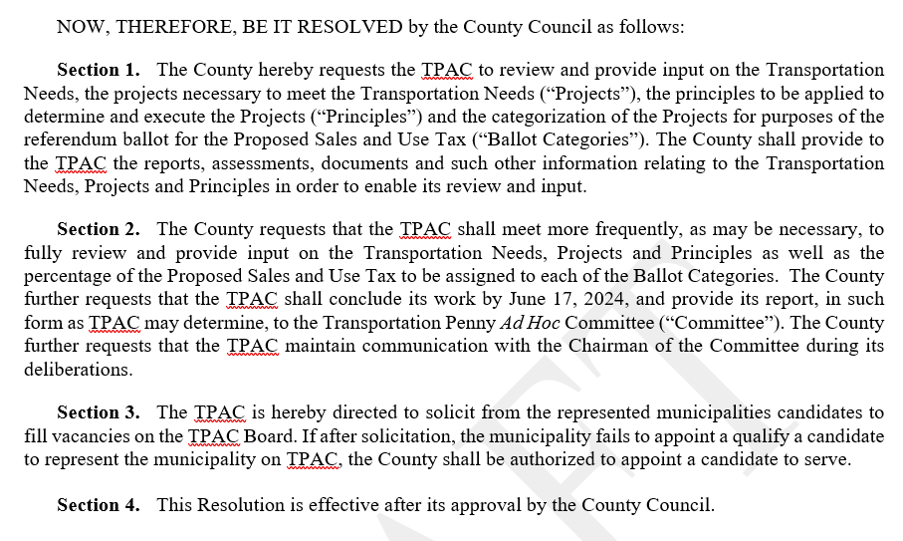
TPAC Resolution (March 19 Council Item)

Slide 19
Roadmap Review
March 19: Council Meeting, Approve TPAC Resolution
March 26: TAHC Meeting, Projects and Principles
April 1: TPAC Meeting, Projects and Principles
April 9: Council Meeting, 1st Reading Penny Tax Referendum Ordinance
April 15: TPAC Meeting, Projects and Principles
April 16: TAHC Meeting, Projects and Principles
April 23: Council Work Session #2, TAHC Report
May 6: TPAC Meeting, Allocation of funds to Categories
May 7: TAHC Meeting, Allocation of funds to Categories
May 7: Council Meeting, 2nd Reading
May 20: TPAC Meeting
May 21: TAHC Meeting
June 3: TPAC Meeting, Finalize Recommendations
June 17: TPAC Meeting, Deadline for Recommendations
June 18: TAHC Meeting, Receive and Review TPAC Recommendations
June 25: Council Work Session #3, TAHC Report, Finalize Projects and Principles, Finalize Allocations
July 9: Public Hearing on Penny Ordinance
July 16: Council Meeting, Final Reading on Penny Ordinance, Adopt Resolution approving Projects and Principles
July 29: Council Work Session #4
All specially called meetings are denoted with purple text.

